Slide 1

intranet
1. Sparsh shah / krish chanchad
2. aniket Shukla
3. meet mendapara
4. roshini singh
5. vivek purohit
6. stuti limbachaiya
7. Harsh davra
8. Krish menat
9. Mustakim Sayyad

Slide 2
What is intranet ?
(Sparsh/krish.c)
DEFINATION:-An intranet is a private enterprise network, designed to support an organization’s employees to communicate, collaborate and perform their roles. It serves a broad range of purposes and uses, but at its core, an intranet is there to help employees.

Slide 3
Intranet meaning!
*Intranet is defined as private network of computers within an organization with its own server and firewall.
*Moreover we can define Intranet as:Intranet is system in which multiple PCs are networked to be connected to each other.
* PCs in intranet are not available to the world outside of the intranet.
*Usually each company or organization has their own Intranet network and members/employees of that company can access the computers in their intranet.
*Every computer in internet is identified by a unique IP address.Each computer in Intranet is also identified by a IP Address, which is unique among the computers in that Intranet.

Slide 4
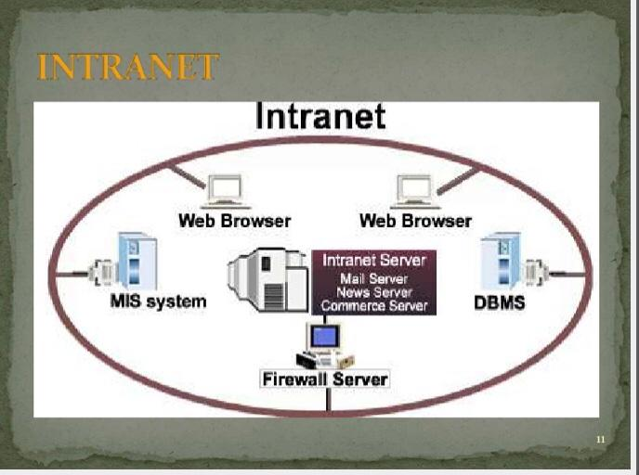
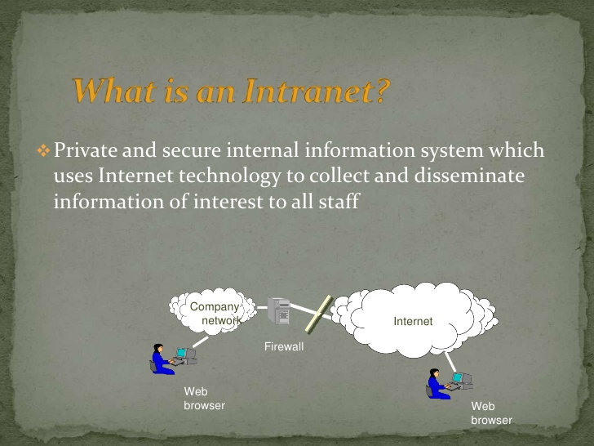
Intranet.

Slide 5
Why we use it ?
(Aniket Shukla)

Slide 6
Use of intranet!
Increased productivity for your teams :
An intranet can: reduce email use; allow for quicker responses on small to medium issues; make information easy to find; give your team access to all the tools and information they need to effectively perform in their role.
• Easy collaboration :
Whether your team are in the same location or not, an intranet makes it possible for your team to: communicate freely; easily exchange ideas; share documents with one another.

Slide 7
Intranet uses!
An engaged, connected workforce :
A well-designed and modern intranet transforms the employee experience to promote efficiency, growth, innovation and connectedness – all key ingredients of an engaged workforce.
Secure knowledge management :
An intranet provides one central place to store all your company documents, that are always up-to-date and can be accessed by anyone on your team.

Slide 8
Uses of intranet!
Strong company culture :
Easy collaboration and communication fosters an environment for your team to interact and get to know one another, especially if you incorporate a social element into your intranet.

Slide 9
Technology behind intranet? (Meet)
*One or more inter-connected TCP/IP network.
THE TCP/IP PROTOCOL SUITEThe protocol stack used on the Internet is the Internet Protocol Suite. It is usually called TCP/IP after two of its most prominent protocols, but there are other protocols as well. The TCP/IP model is based on a five-layer model for networking. From bottom (the link) to top (the user application), these are the physical, data link, network, transport, and application layers. Not all layers are completely defined by the model, so these layers are “filled in” by external standards and protocols. The layers have names but no numbers, and although sometimes people speak of “Layer 2” or “Layer 3,” these are not TCP/IP terms. Terms like these are actually from the OSI Reference Model

Slide 10
Technology behind intranet!
Internet connectivity with firewall protection Servers: Web, E-Mail, Proxy, DNS
Mozilla and the Firefox browser extension developer community have created a range of tools that can simplify and speed up your browser extension development. This page provides a summary of those tools including details on the features each offers, how to get started, where in the development cycle it fits, and links to useful resources.

Slide 11
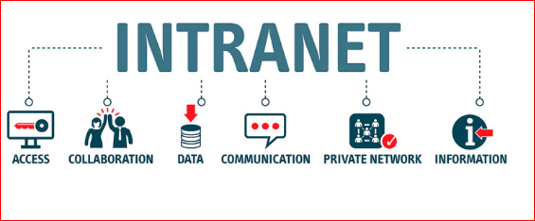
ADVANTAGES OF INTRANET! (roshini)

Slide 12
Advantages of intranet!
COST EFFECTIVE :
The expense of communicating infoRMATION
USING INTRANET IS EXTREMELY LOW .
AVAILABILITY :
By using intranet employees can access
their information anytime and anywhere.

Slide 13
Advantages!
INFORMATION EXCHANGE :
INTRANET CAN BE USED AS A COMMUNICATION HUB
WHERE EMPLOYEES STORE INFORMATION WHENEVER THEY
WANTED .
WEB PUBLISHING :
ALL THE INFORMATIONS CAN BE VIEWED VIA WEB BROWSER.

Slide 14
Intranet advantages.
DECISION MAKING :
FOR AN EFFECTIVE DECISION MAKING THERE
SHOULD BE ADEQUATE INFORMATIONS AVAILABLE .
COLLABORATION :
ANOTHER BENEFIT OF INTRANET IS THE LEVEL OF
COLLABORATION IT PROVIDES .

Slide 15
Disadvantage of intranet.
(VIVEK)

Slide 16
DISADVANTAGES OF INTRANET!
Implementation and complexity
The cost of implementing intranets are usually high (Depending on the type of intranet solutions and the number of users). Additionally it needs separate training and upgrade for using the intranet solution effectively. All these require time and effort which makes it difficult the implementation process.
Intranets are considered to be complex in nature. Due to their complexity many employees feel overwhelmed and unwilling to use it. And also intranet users needs to do separate administration which can be time consuming.

Slide 17
Security and onboarding.
Al though intranet systems doe contain many security measures, it is still vulnerable to security risks. Unless there are firewalls or gateways, your private informations can be accessed by a third party. Therefore, when using intranet there is a loss of privacy for the corporates.
In intranet always the employees should be satisfied at the point of launch. If there are no valued content, staff will not use it anymore. Therefore, content plays an important role here.

Slide 18
Updates OF INTRANET.
An intranet solution that gets frequently updated is less prone to usability issues. But the problem remains in finding one. It can be extremely challenging to find an intranet solution that remains updated. These kinds of intranet systems most at times lack customer support. Hence, employees of the company will have a problem adopting to it.

Slide 19
HISTORY OF INTRANET! (sTUTI)
In accordance to sources, the birth of the intranet fell on a 1994 – 1996, that was true prehistory from an IT systems point of view. Intranet history is bound up with the development of Internet – the global network. The idea of WWW, proposed in 1989 by Tim Berners-Lee and others, which aim was to enable the connection and access to many various sources, became the prototype for the first internal networks. The goal of intranet invention was to increase employees productivity through the easier access to documents, their faster circulation and more effective communication. Although, access to information was always a crucial matter, in fact, intranet offered lots more functionalities, i.e.: e-mail, group work support, audio-video communication, texts or personal data searching.

Slide 20
Diffference between intranet and internet. (HARSH)
The Internet is a global system of computer networks available for everyone, whereas Intranet is a network of computers owned by any organization for a certain group of people.A
The Internet is a public network, while Intranet is a private network.
The total number of users using the Internet is very high, whereas total users on Intranet are limited.
Information on the Internet is broad that involves almost every topic, category and field. In contrast, Intranet includes limited information that refers to any group or organization, such as the company's databases.
The Internet can be accessed and used by anyone, whereas the Intranet is limited to organization employees or admin with login details.
The Internet is a public network that is not considered safe, while the Intranet is a safer network.
The intranet is usually owned by a firm, institution, or organization, but any single person or an organization does not own the internet

Slide 21
DIFFERENCE BETWEEN INTRANET AND EXTRANET. (KRISH.M)
INTRANET-
An intranet is a private association, worked by an immense association or other affiliation, which uses web progresses, yet is shielded from the overall web
EXTRANET
An extranet is an intranet that is available to specific people from outside the association, or possibly shared by more than one affiliation.

Slide 22
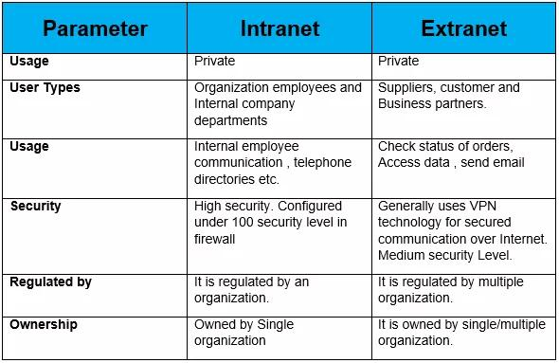
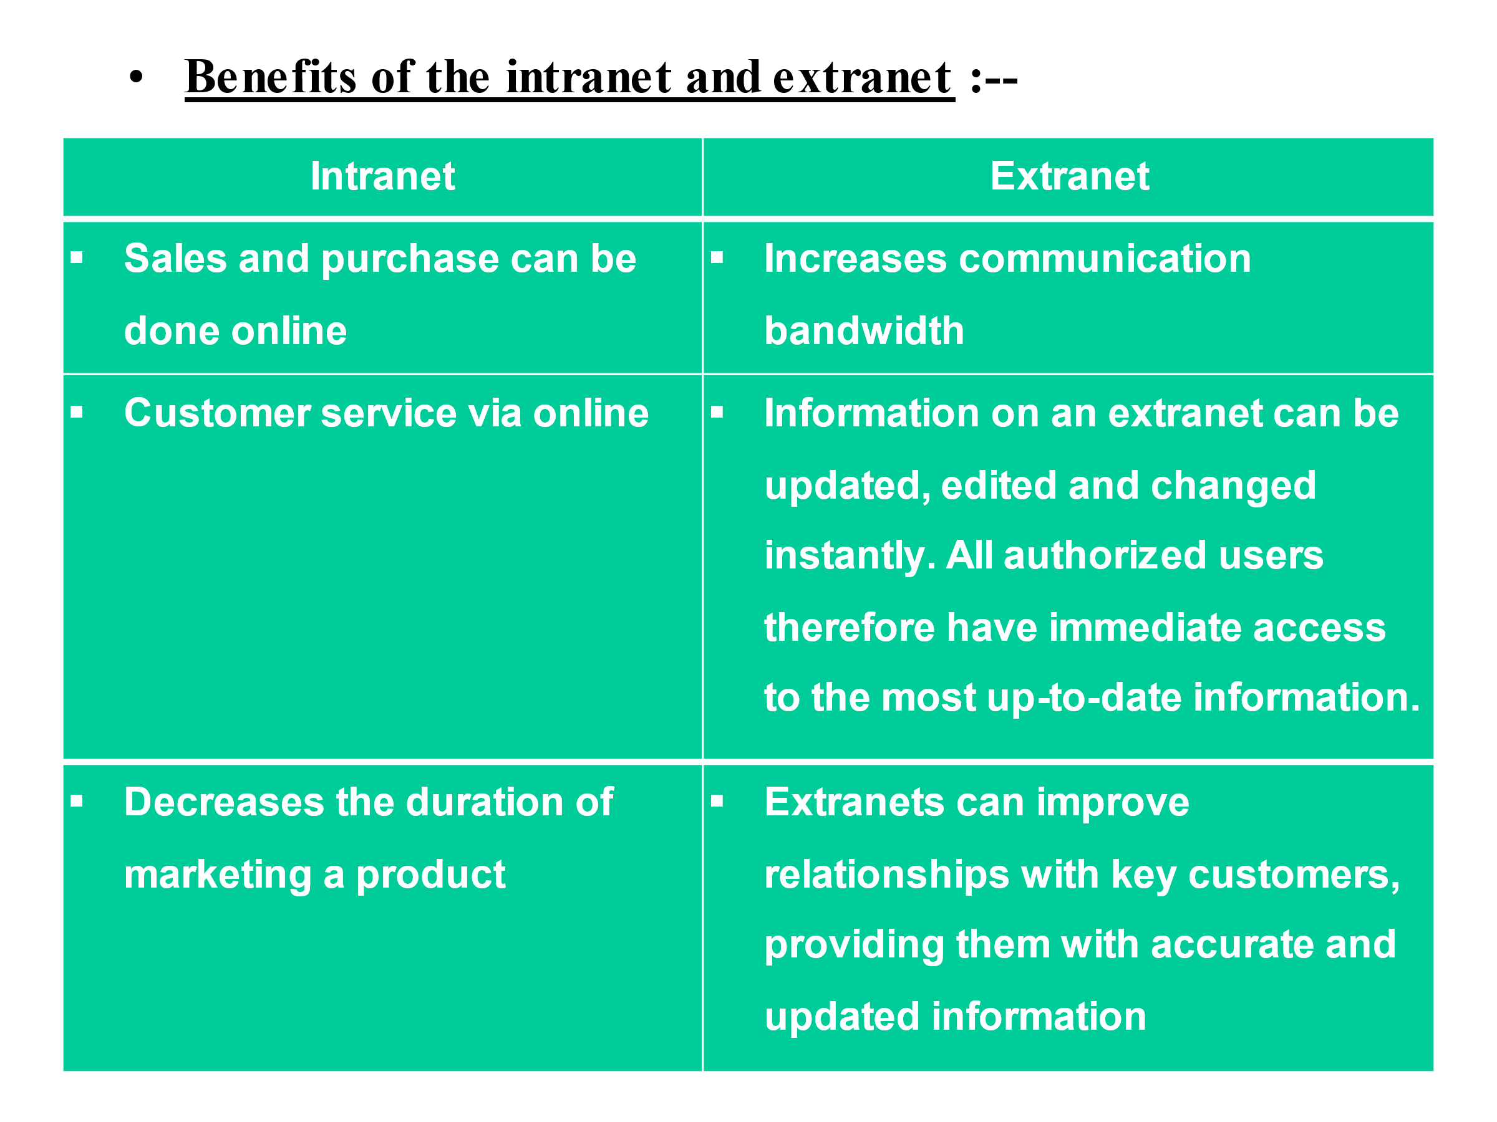
DIFFERENCE BETWEEN INTRANET & EXTRANET.

Slide 23
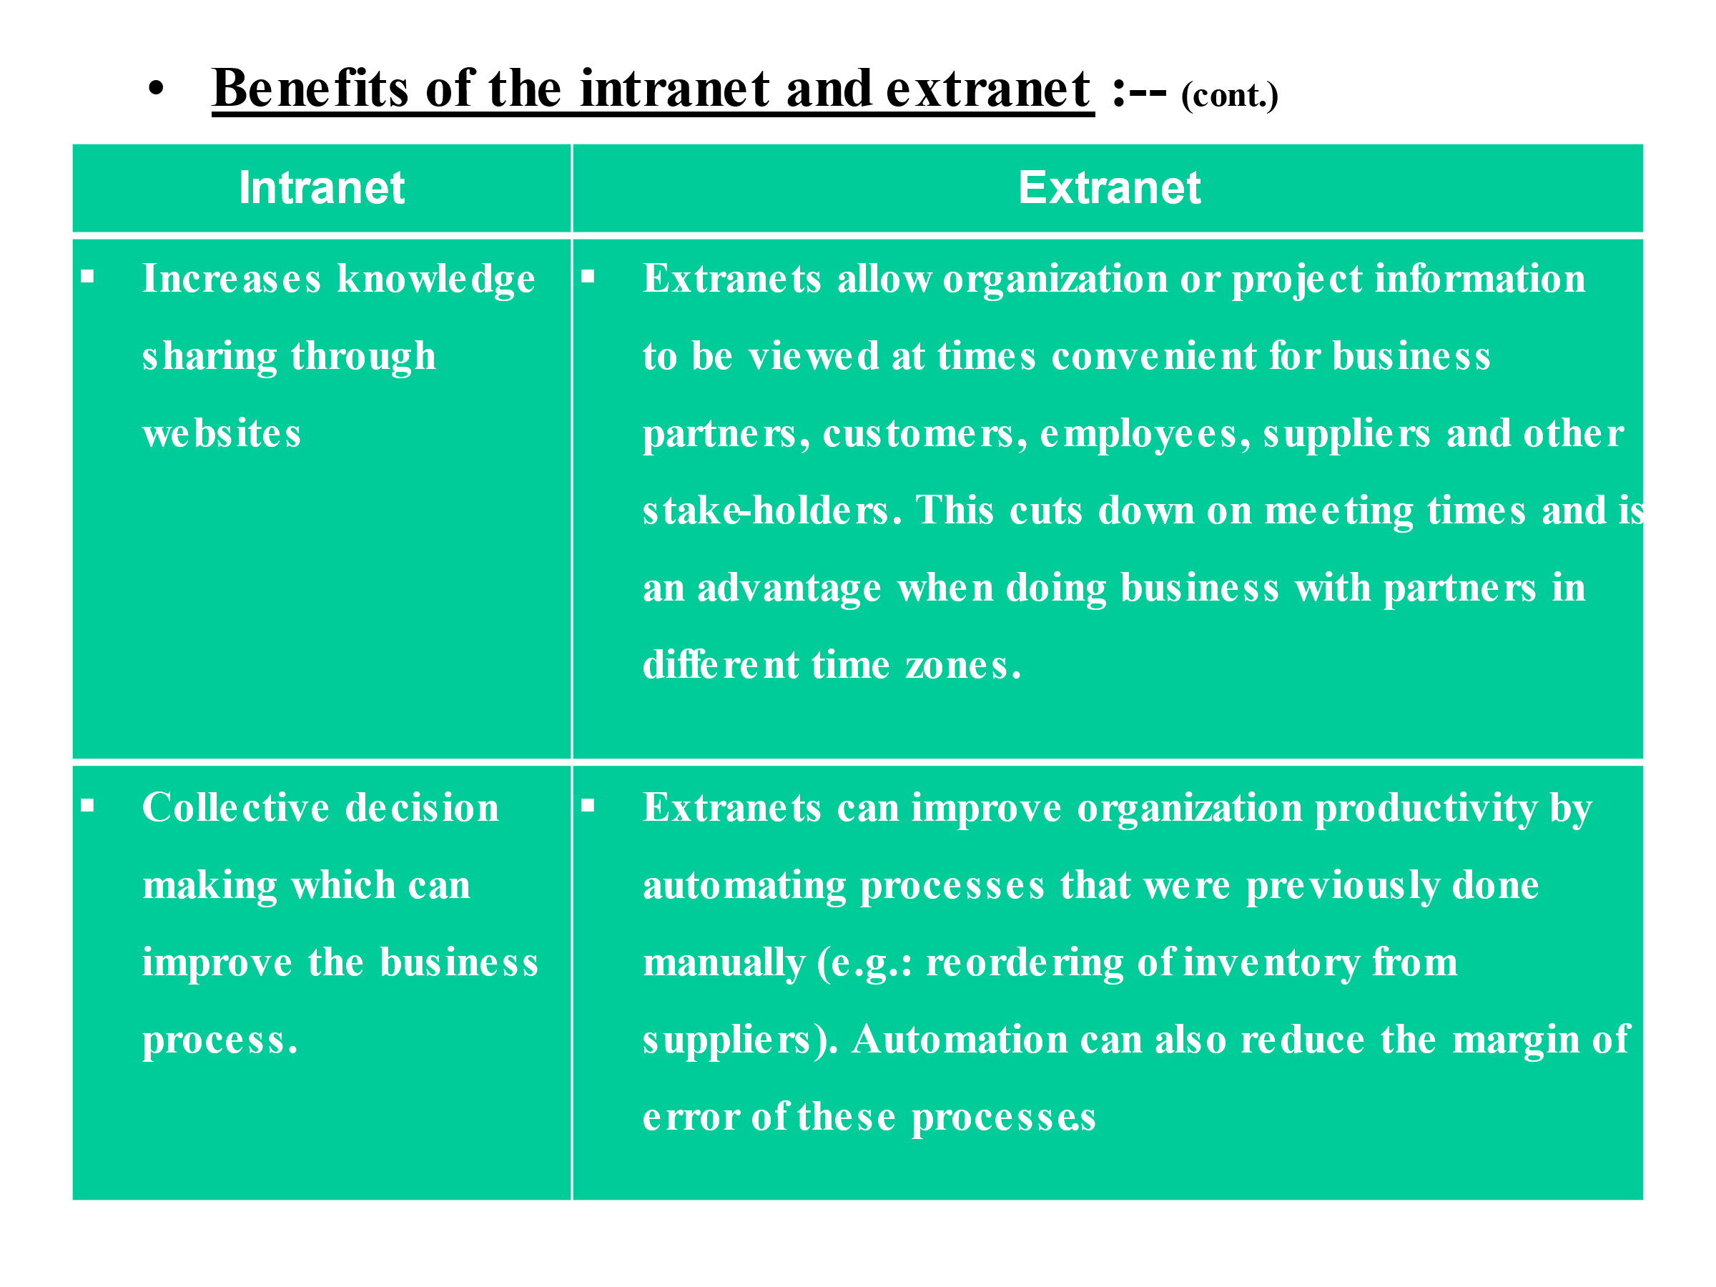
BENEFITS OF INTRANET & EXTRANET!

Slide 24
THANK you!!ag
1. (107)Sparsh Shah / (04)Krish Chanchad
2. (85)Aniket Shukla
3. (144)Meet Mendapara
4. ()Roshini Singh
5. (68)Vivek Purohit
6. (125)Stuti Limbachaiya
7. (09)Harsh Davra
8. (43)Krish Menat
9.(75) musatkim sayyad

